Slide 1
Process & Thread Management
Concept of process and threads
Process states
Process management
Context switching
Interaction between processes and OS
Multithreading
Example OS : Linux

Slide 2
Process
Process – a program in execution;
Program is a passive entity , whereas process is a active entity.
process execution must progress in sequential fashion
A process includes:
program counter
Stack ( contain local variables, parameters, return addresses)
data section ( contain global variables)

Slide 3
Multiprogramming
Computers (at least uniprocessors) don’t really run multiple programs simultaneously, it just looks that way
Each process runs to completion, but is interleaved with other processes
As a process runs, it may have to wait for things like user input or disk I/O
While one process waits, another can run
This is multiprogramming

Slide 4
Process Concept
An operating system executes a variety of programs:
Batch system – jobs
Time-shared systems – user programs or tasks
Textbook uses the terms job and process almost interchangeably
Process – a program in execution; process execution must progress in sequential fashion
A process includes:
program counter
stack
data section
code
heap
allocated memory

Slide 5
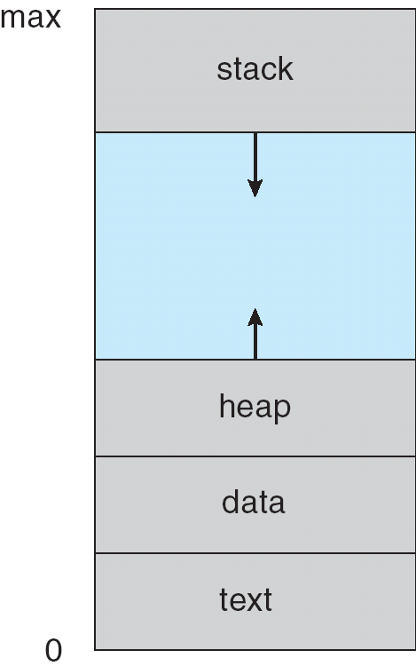
Processes in Memory
Process A
Process B

Slide 6
Processes and Scheduling
Processes have isolation from each other
Address space
Security context
Termination protection
Processes are scheduled separately from each other
One process blocking or being pre-empted allows another to run
On some systems, a process can be composed of several threads which share the process
On a multiprocessor, processes can and do run simultaneously

Slide 7
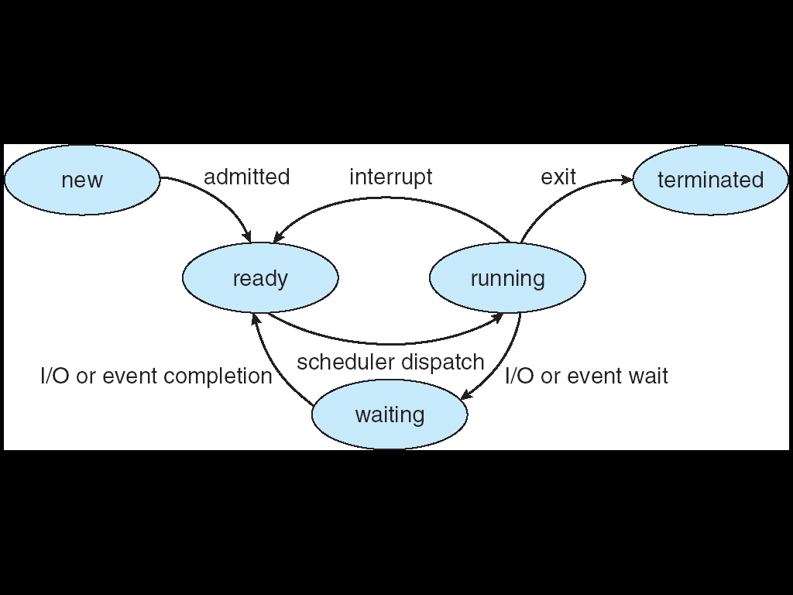
Diagram of Process State
As a process executes, it changes state
new: The process is being created
running: Instructions are being executed
waiting: The process is waiting for some event to occur
ready: The process is waiting to be assigned to a process
terminated: The process has finished execution

Slide 8
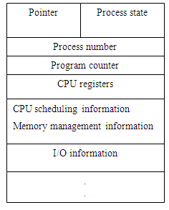
Process Control Block (PCB)
Program counter contains the address of the next instruction to be executed.
CPU registers which include the accumulator, general purpose registers, index register, stack pointer.
CPU scheduling information consists of parameters for scheduling various processes by the CPU,process priority, pointers to scheduling queue.
Memory management information includes information pertaining to base registers, limit registers, page tables, segment tables.
I/O status information includes list of I/O devices allocated,list of open files

Slide 9
Process Control Block (PCB)
I/O Status information. This information includes the list of I/O devices allocated to the process, a list of open files, and so on.

Slide 10
Context Switch
When CPU switches to another process, the system must save the state of the old process and load the saved state for the new process
Context-switch time is overhead; the system does no useful work while switching
Time dependent on hardware support

Slide 11
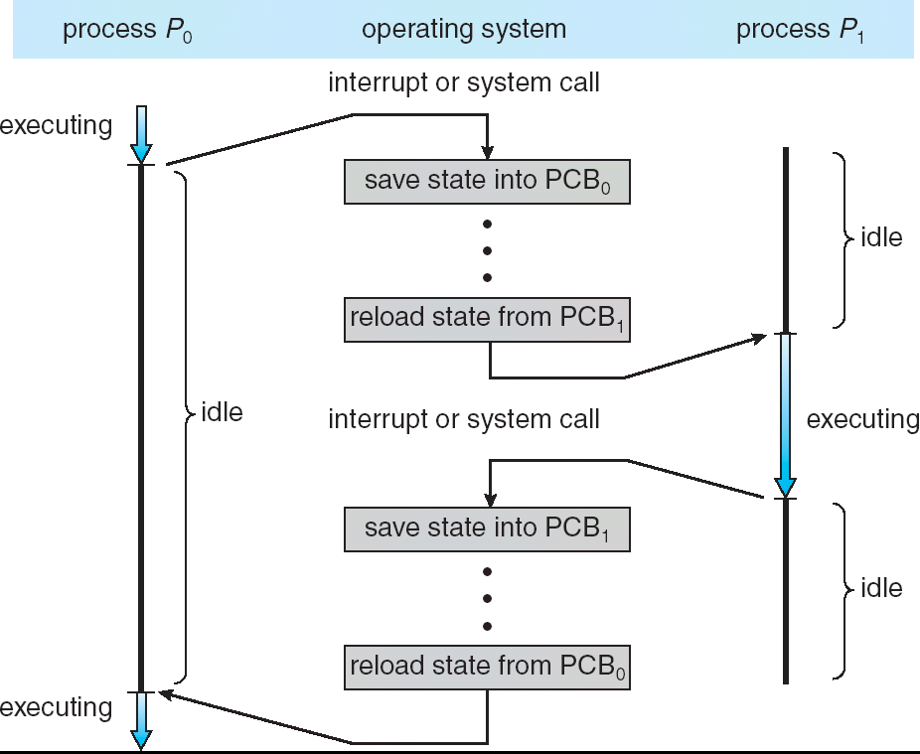
CPU Switch From Process to Process

Slide 12
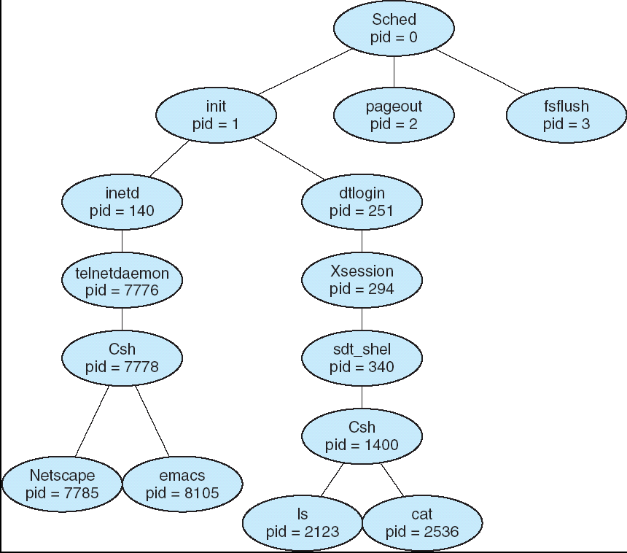
A tree of processes on a typical Solaris

Slide 13
Process Creation
Parent process create children processes, which, in turn create other processes, forming a tree of processes
Resource sharing
Parent and children share all resources
Children share subset of parent’s resources
Parent and child share no resources
Execution
Parent and children execute concurrently
Parent waits until children terminate

Slide 14
Process Scheduling
The objective of multiprogramming is to have some process running at all times.
To maximize the CPU utilization scheduling is done among various processes.
Job queue – set of all processes in the system
Ready queue – set of all processes residing in main memory, ready and waiting to execute .
A ready queue header contains pointer to first & last PCBs in the linked list.
Each PCB has pointer, points to next process in queue.
Device queues – set of processes waiting for an I/O device
Processes migrate among the various queues

Slide 15
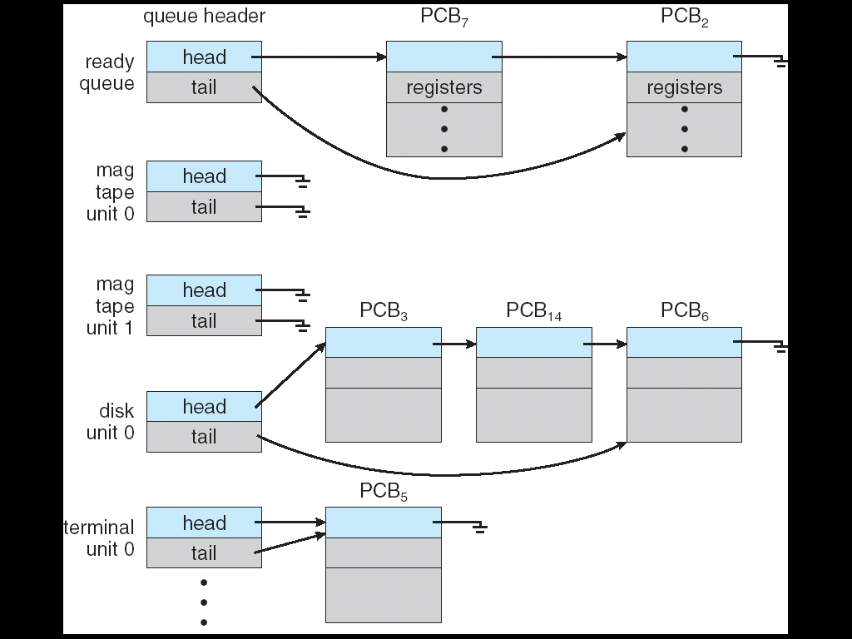
Process Scheduling
A new Process is put in ready queue. It waits in queue until it is selected for execution(dispatched )& given to CPU.
Process issue I/O request, enters I/O queue.
Process creates new process & waits for its termination.
Process removed from CPU due to interrupt & again placed in ready queue.
Ready Queue And Various I/O Device Queues

Slide 16
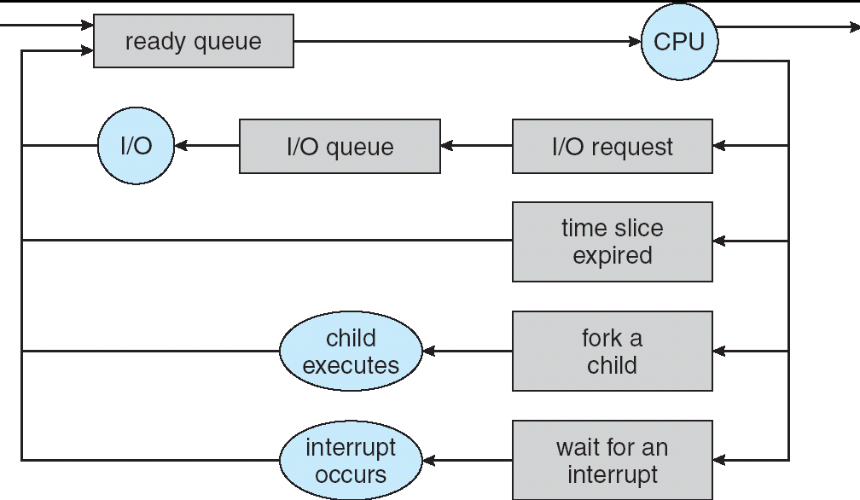
Process Scheduling
Queuing representation of process scheduling
Processes can be described as either:
I/O-bound process – spends more time doing I/O than computations, many short CPU bursts
CPU-bound process – spends more time doing computations; few very long CPU bursts

Slide 17
CPU Schedulers
Long-term scheduler (or job scheduler)
selects which processes from secondary storage should be brought into the ready queue.
Short-term scheduler (or CPU scheduler)
selects which process should be executed next(from ready queue) and allocates CPU.

Slide 18
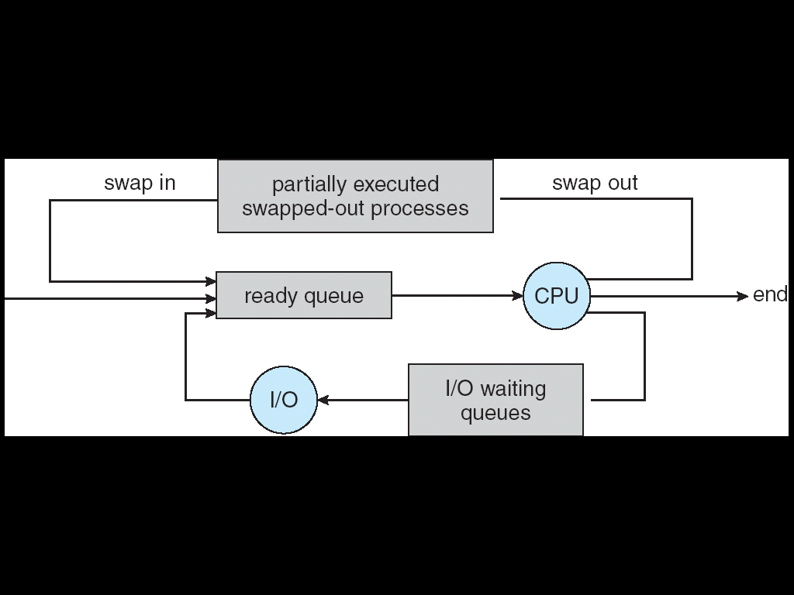
Medium term scheduler
It removes processes from memory and swaps to disk to reduce the degree of multiprogramming to increase throughput.

Slide 19
Long term scheduler | Short term scheduler | Medium term scheduler
Selects the process from the disk and loads them into main memory for execution, puts in ready queue | Chooses the process from ready queue and assigns it to CPU | Swaps in and out the process from memory
Speed is less | Speed is fast | Speed is moderate
Transition of process from New to Ready | Transition of process from Ready to executing | No process state transtition
Not present in time sharing system | Minimal in Time sharingsystem | Present in Time sharing system
Supply a reasonable mix of jobs, such as I/O bound and CPU bound | Select a new process to allocate to CPU frequently | Process are swapped in and out for balanced process mix

Slide 20
Long term scheduler | Short term scheduler | Medium term scheduler
Controls degree of multiprogramming through placing process in ready queue | It has a control over degree of multiprogramming as it allocates process to CPU | Reduce the degree of multiprogramming by swapping process in and out
It is called as job scheduler | It is called as CPU scheduler

Slide 21
Context Switch
The machine register contain the hardware context of currently running process. When a context switch occurs, these registers are saved in PCB of current process.
When CPU switches to another process, the system must save the state of the old process and load the saved state for the new process.
Context-switch time is overhead; the system does no useful work while switching.
Context switch time dependent on hardware support. For example, if register contents do not have to be saved because of the availability of large number of registers, then context switch time will be low.

Slide 22
Context Switch

Slide 23
Scheduling Criteria
CPU utilization – keep the CPU as busy as possible
Throughput – # of processes that complete their execution per time unit
Turnaround time – amount of time to execute a particular process
Waiting time – amount of time a process has been waiting in the ready queue
Response time – amount of time it takes from when a request was submitted until the first response is produced, not output (for time-sharing environment)

Slide 24
Optimization Criteria
Max CPU utilization
Max throughput
Min turnaround time
Min waiting time
Min response time

Slide 25
Types of Scheduling
Non-Preemptive
Preemptive

Slide 26
Types of Scheduling algorithm
First in First out(FIFO)
Shorest Job First (SJF)
Priority Scheduling
Round Robin Scheduling
Multilevel Queue Scheduling
Multilevel Feedback Queue Scheduling

Slide 27
First-Come, First-Served (FCFS) Scheduling
Process Burst Time
P₁ 24
P₂ 3
P₃ 3
With FCFS, the process that requests the CPU first is allocated the CPU first
Case #1: Suppose that the processes arrive in the order: P₁ , P₂ , P₃
Gantt Chart :
Waiting time for P₁ = 0; P₂ = 24; P₃ = 27
Average waiting time: (0 + 24 + 27)/3 = 17
Average turn-around time: (24 + 27 + 30)/3 = 27
P₁
P₂
P₃
0
24
27
30

Slide 28
FCFS Scheduling (Cont.)
Case #2: Suppose that the processes arrive in the order: P₂ , P₃ , P₁
Gantt chart:
Waiting time for P₁ = 6; P₂ = 0; P₃ = 3
Average waiting time: (6 + 0 + 3)/3 = 3 (Much better than Case #1)
Average turn-around time: (3 + 6 + 30)/3 = 13
P₂
P₃
P₁
0
3
6
30

Slide 29
FCFS Scheduling (Cont.)
Case #1 is an example of the convoy effect; all the other processes wait for one long-running process to finish using the CPU
This problem results in lower CPU and device utilization; Case #2 shows that higher utilization might be possible if the short processes were allowed to run first
The FCFS scheduling algorithm is non-preemptive
Once the CPU has been allocated to a process, that process keeps the CPU until it releases it either by terminating or by requesting I/O
It is a troublesome algorithm for time-sharing systems

Slide 30
Shortest-Job-First (SJR) Scheduling
Associate with each process the length of its next CPU burst. Use these lengths to schedule the process with the shortest time.
Two schemes:
nonpreemptive – once CPU given to the process it cannot be preempted until completes its CPU burst.
preemptive – if a new process arrives with CPU burst length less than remaining time of current executing process, preempt. This scheme is know as the Shortest-Remaining-Time-First (SRTF).
SJF is optimal – gives minimum average waiting time for a given set of processes.

Slide 31

Example #1: Non-Preemptive SJF (simultaneous arrival)
Process Arrival Time Burst Time
P₁ 0.0 6
P₂ 0.0 4
P₃ 0.0 1
P₄ 0.0 5
SJF (non-preemptive, simultaneous arrival)
Average waiting time = (0 + 1 + 5 + 10)/4 = 4
Average turn-around time = (1 + 5 + 10 + 16)/4 = 8

Slide 32
Example #2: Non-Preemptive SJF (varied arrival times)
Process Arrival Time Burst Time
P₁ 0.0 7
P₂ 2.0 4
P₃ 4.0 1
P₄ 5.0 4
SJF (non-preemptive, varied arrival times)
Average waiting time = ( (0 – 0) + (8 – 2) + (7 – 4) + (12 – 5) )/4 = (0 + 6 + 3 + 7)/4 = 4
Average turn-around time: = ( (7 – 0) + (12 – 2) + (8 - 4) + (16 – 5))/4 = ( 7 + 10 + 4 + 11)/4 = 8
P₁
P₃
P₂
P₄
0
3
7
8
12
16
Waiting time : sum of time that a process has spent waiting in the ready queue

Slide 33
Example #3: Preemptive SJF (Shortest-remaining-time-first)
Process Arrival Time Burst Time
P₁ 0.0 7
P₂ 2.0 4
P₃ 4.0 1
P₄ 5.0 4
SJF (preemptive, varied arrival times)
Average waiting time = ( [(0 – 0) + (11 - 2)] + [(2 – 2) + (5 – 4)] + (4 - 4) + (7 – 5) )/4 = 9 + 1 + 0 + 2)/4 = 3
Average turn-around time = ([16-0] + [7-2] + [5-4] +[11-5])/4 = 7
P₁
P₂
P₃
P₂
P₄
P₁
0
2
4
5
7
11
16
Waiting time : sum of time that a process has spent waiting in the ready queue

Slide 34
Priority Scheduling
A priority number (integer) is associated with each process
Priority scheduling is a form of preemptive scheduling where priority is the basis of preemption.
It can be non-preemptive also.
(smallest integer ≡ highest priority)
Problem ≡ Starvation – low priority processes may never execute.
Solution ≡ Aging – as time progresses increase the priority of the process.

Slide 35
Priority Scheduling
Process Burst Time Priority
P1 10 3
P2 1 1
P3 2 4
P4 1 5
P5 5 2
Process Burst Time Priority Arrival time
P1 10 3 0
P2 5 2 1
P3 2 1 2

Slide 36
Round Robin (RR)
Each process gets a small unit of CPU time (time quantum), usually 10-100 milliseconds. After this time has elapsed, the process is preempted and added to the end of the ready queue.
If there are n processes in the ready queue and the time quantum is q, No process waits more than (n-1)q time units.
Performance
q large ⇒ FIFO
q small ⇒ q must be large w.r.t. context switch, otherwise overhead is too high.
One rule of thumb is that 80% of the CPU bursts should be shorter than the time quantum

Slide 37
Example of RR with Time Quantum = 4 ms
Process Burst Time
P₁ 11
P₂ ₇
P₃ 15
P₄ 4
The Gantt chart is:
Typically, higher average turnaround than SJF, but better response time
Average turn-around time = (30-0)+(23-0)+(37-0)+(16-0)
=30 + 23 + 37 + 16) / 4 = 26.5
Average waiting time = [0+(16-4)+(27-20)]+[4+(20-8)]+[8+(23-12)+(30-27)]+[12]
= (19+4+22+12)/4 =14.25
P₁
P₂
P₃
P₄
P₁
P2
P₃
P₁
P₃
P₃
0
4
8
12
16
20
23
27
30
34
37

Slide 38
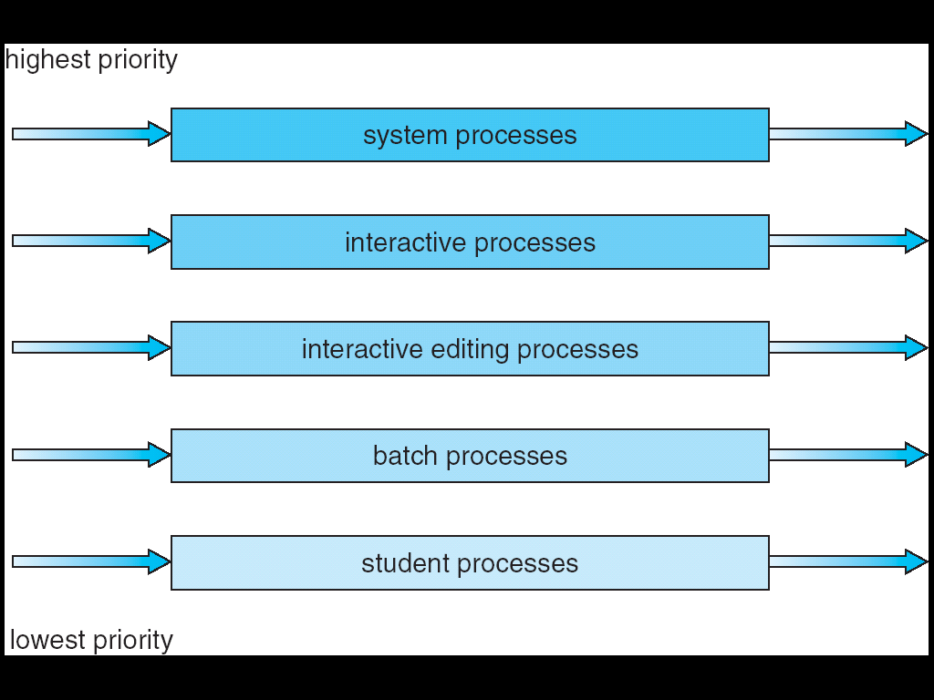
Multi-level Queue Scheduling

Slide 39
Multi-level Queue Scheduling
Multi-level queue scheduling is used when processes can be classified into groups
For example, foreground (interactive) processes and background (batch) processes
The two types of processes have different response-time requirements and so may have different scheduling needs
Also, foreground processes may have priority (externally defined) over background processes
A multi-level queue scheduling algorithm partitions the ready queue into several separate queues
The processes are permanently assigned to one queue, generally based on some property of the process such as memory size, process priority, or process type

Slide 40
Multi-level Queue Scheduling
Each queue has its own scheduling algorithm
The foreground queue might be scheduled using an RR algorithm
The background queue might be scheduled using an FCFS algorithm
In addition, there needs to be scheduling among the queues, which is commonly implemented as fixed-priority pre-emptive scheduling
The foreground queue may have absolute priority over the background queue
One example of a multi-level queue are the five queues shown below
Each queue has absolute priority over lower priority queues
For example, no process in the batch queue can run unless the queues above it are empty
However, this can result in starvation for the processes in the lower priority queues

Slide 41
Multilevel Queue Scheduling
Another possibility is to time slice among the queues
Each queue gets a certain portion of the CPU time, which it can then schedule among its various processes
The foreground queue can be given 80% of the CPU time for RR scheduling
The background queue can be given 20% of the CPU time for FCFS scheduling

Slide 42
Multilevel Feedback Queue Scheduling
In multi-level feedback queue scheduling, a process can move between the various queues; aging can be implemented this way
A multilevel-feedback-queue scheduler is defined by the following parameters:
Number of queues
Scheduling algorithms for each queue
Method used to determine when to promote a process
Method used to determine when to demote a process
Method used to determine which queue a process will enter when that process needs service

Slide 43
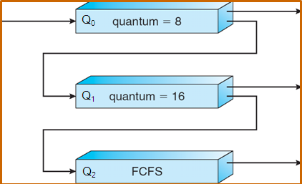
Example of Multilevel Feedback Queue
Scheduling
A new job enters queue Q₀ (RR) and is placed at the end. When it gains the CPU, the job receives 8 milliseconds. If it does not finish in 8 milliseconds, the job is moved to the end of queue Q₁.
A Q₁ (RR) job receives 16 milliseconds. If it still does not complete, it is preempted and moved to queue Q₂ (FCFS).

Slide 44
Multithreading
Multithreading refers to the ability of an OS to support multiple , concurrent paths of execution within a single process.
A thread is a basic unit of CPU utilization; it comprises a thread ID, a program counter, a register set, and a stack.
It shares with other threads belonging to the same process its code section, data section, and other operating-system resources, such as open files and signals.
A traditional (or heavyweight) process has a single thread of control.
If a process has multiple threads of control, it can perform more than one task at a time.

Slide 45
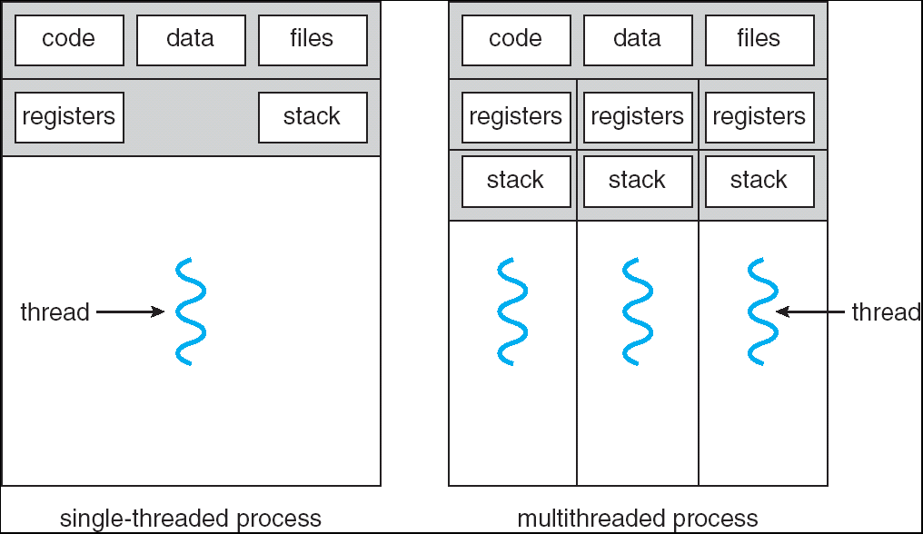
Single and Multithreaded Processes

Slide 46
Multithreading (Benefits)
Responsiveness: Multithreading an interactive application increases responsiveness to the user.
Resource Sharing: Threads share memory and resources of the processes to which they belong.
Economy: Process creation is expensive.
Utilization of Multiprocessor Architectures: Benefits of multithreading increase in multiprocessor systems because different threads can be scheduled to different processors

Slide 47
Difference Process / Thread
Process | Thread
Program in execution | It is the part of process
It is heavy weight process | It is light weight process
Process context switch takes more time | Thread context switch takes less time
New process creation, termination takes more time | New Thread creation, termination takes lesse time
Each process executes the same code but has its own memory ad file resources | All thread can share same set of open files, child process
In process based implementation if one process is blocked , no other server process can execute until the first process unblocked | In multithreaded server implementation, if one thread blocked and waiting, second thread in the same process could execute
Multiple redundant process use more resources | Multiple threaded process use fewer resources

Slide 48
Multithreading: Types of threads
User level threads
Kernel level threads

Slide 49
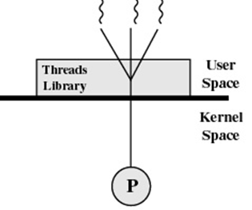
Multithreading: Types of threads
User level threads
Threads are implemented at user level by Thread Library: creates, scheduling and management of threads without kernel involvement.
Hence fast to create & manage.
Status of information table is maintained within Thread Library hence better scalability.

Slide 50
User level threads
ADVANTAGES
Thread switching does not require Kernel mode privileges.
User level thread can run on any operating system.
Scheduling can be application specific in the user level thread.
User level threads are fast to create and manage.
Supported above the kernel, via a set of library calls at the user level
Fast switching among threads: Threads do not need to call OS and cause interrupts to kernel – a user-level threads package can be implemented on an Operating System that does not support threads.
User-level threads does not require modification to operating systems

Slide 51
User level threads
Disadvantages
When a user level thread executes a blocking system call, not only that thread is blocked, but also all of the threads within the process are blocked.
There is a lack of coordination between threads and operating system kernel.
Therefore, process as whole gets one time slice irrespective of whether process has one thread or 1000 threads within.
It is up to each thread to relinquish control to other threads
Multithreaded application cannot take advantage of multiprocessing

Slide 52
User level threads
Example thread libraries: –
POSIX Pthreads
Win32 threads
Java threads

Slide 53
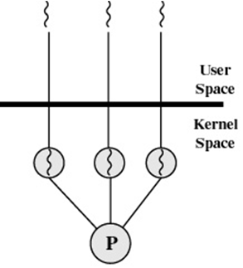
Multithreading: Types of threads
Kernel Threads
Kernel maintains process table and keeps track of all processes.
Kernel threads are slow & insufficient because it requires a full TCB(Thread Control Block) for each thread to manage and schedule.

Slide 54
Kernel Threads
ADVANTAGES
Kernel can simultaneously schedule multiple threads from the same process on multiple processes.
If one thread in a process is blocked, the Kernel can schedule another thread of the same process.
Kernel routines themselves can multithreaded.
DISADVANTAGES
Kernel threads are generally slower to create and manage than the user threads.
Transfer of control from one thread to another within same process requires a mode switch to the Kernel.

Slide 55
Kernel Threads
The kernel-level threads are slow and inefficient . For instance, threads operations are hundreds of times slower than that of user-level threads. – Since kernel must manage and schedule threads as well as processes. It require a full thread control block (TCB) for each thread to maintain information about threads. As a result there is significant overhead and increased in kernel complexity. • Examples – Windows XP/2000, Solaris, Linux, Tru64 UNIX, Mac OS X
Disadvantages – The kernel-level threads are slow and inefficient .
For instance, threads operations are hundreds of times slower than that of user-level threads.
Since kernel must manage and schedule threads as well as processes.
It require a full thread control block (TCB) for each thread to maintain information about threads.
As a result there is significant overhead and increased in kernel complexity

Slide 56
Kernel Threads
Examples – Windows XP/2000, Solaris, Linux, Tru64 UNIX, Mac OS X

Slide 57
Difference between User Level & Kernel Level Thread
User Level thread | Kernel Level Thread
User level threads are faster to create and manage | Kernel level threads are slower to create and manage.
Implementation is by a thread library at the user level. | Operating system supports creation of Kernel threads
User level thread is generic and can run on any operating system | Kernel level thread is specific to the operating system
Multi-threaded application cannot take advantage of multiprocessing | Kernel routines themselves can be multithreaded.

Slide 58
Multithreading: Thread Models
Many-to-One Model
One-to-one Model
Many-to-Many Model

Slide 59
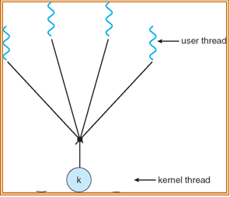
Multithreading: Many-to-One Model
Many-to-One: maps many user level threads into one kernel level thread.
The entire process will block if a thread makes a blocking system call
Since only one thread can access kernel at a time, multiple threads cannot run concurrently and thus cannot make use of multiprocessors

Slide 60
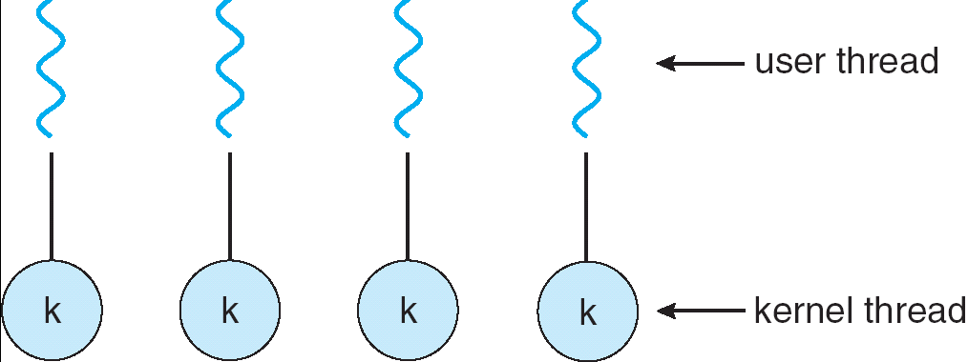
Multithreading: One-to-One Model
One-to-One: maps each user level thread to a kernel level thread
Creating a user level thread results in creating a kernel thread
More overhead and allows parallelism
Because of the overhead most implementations limit the number of kernel threads created

Slide 61
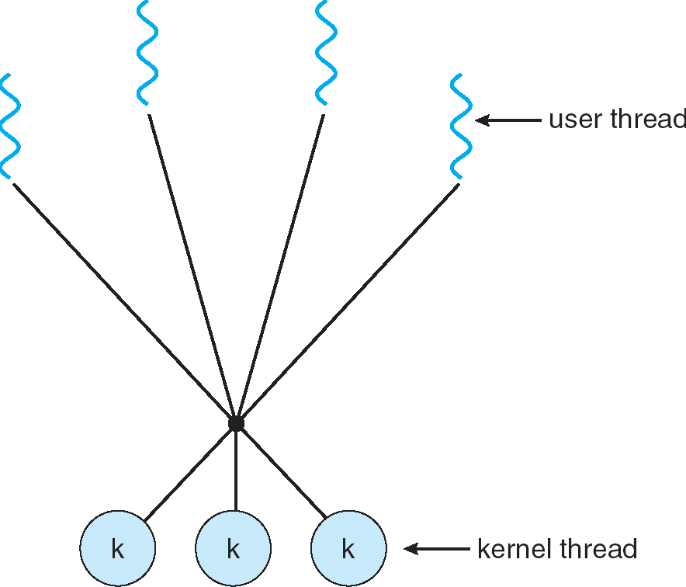
Multithreading: Many-to-Many Model
Many-to-Many: Multiplexes many user level threads to a smaller or equal number of kernel threads
Has the advantages of both the many-to-one and one-to-one model

Slide 62
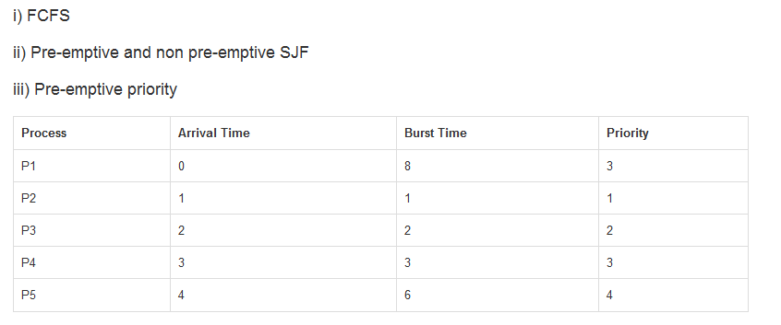

Slide 63
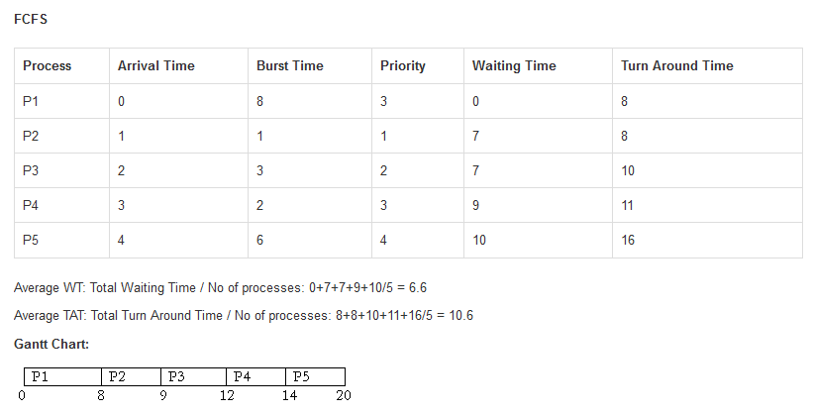

Slide 64
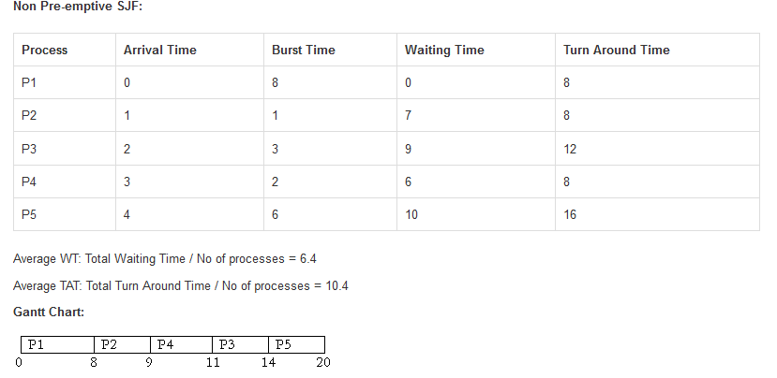

Slide 65
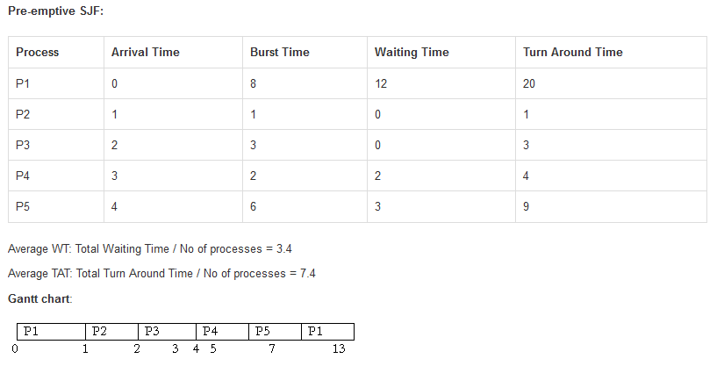
P1
P2
P3
P4
P5
P1
0
1
2
5
7
13
20

Slide 66
